Slide 1
Clean Code
Prepared by eng Hosam Hazem

Slide 2
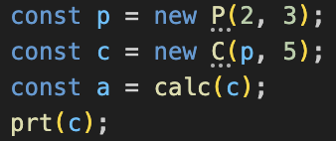
What does this code do?

Slide 3
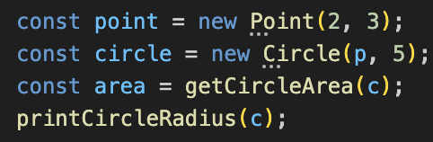
What does this code do?

Slide 4
Any fool can write code that a computer can understand. Good programmers write code that humans can understand.
Martin Fowler

Slide 5
What is a clean Code
If it is working it does not mean it is clean.
must be readable.
You are not only a programmer you are an AUTHOR!!
We spend majority of our time reading Codes. Don't we?
  Our colleague code, stack overflow,
  Our code now, our code before and our code in the future,
Spending time to make it clean will save a lot more reading it.
It is a grading criteria in our project!!

Slide 6
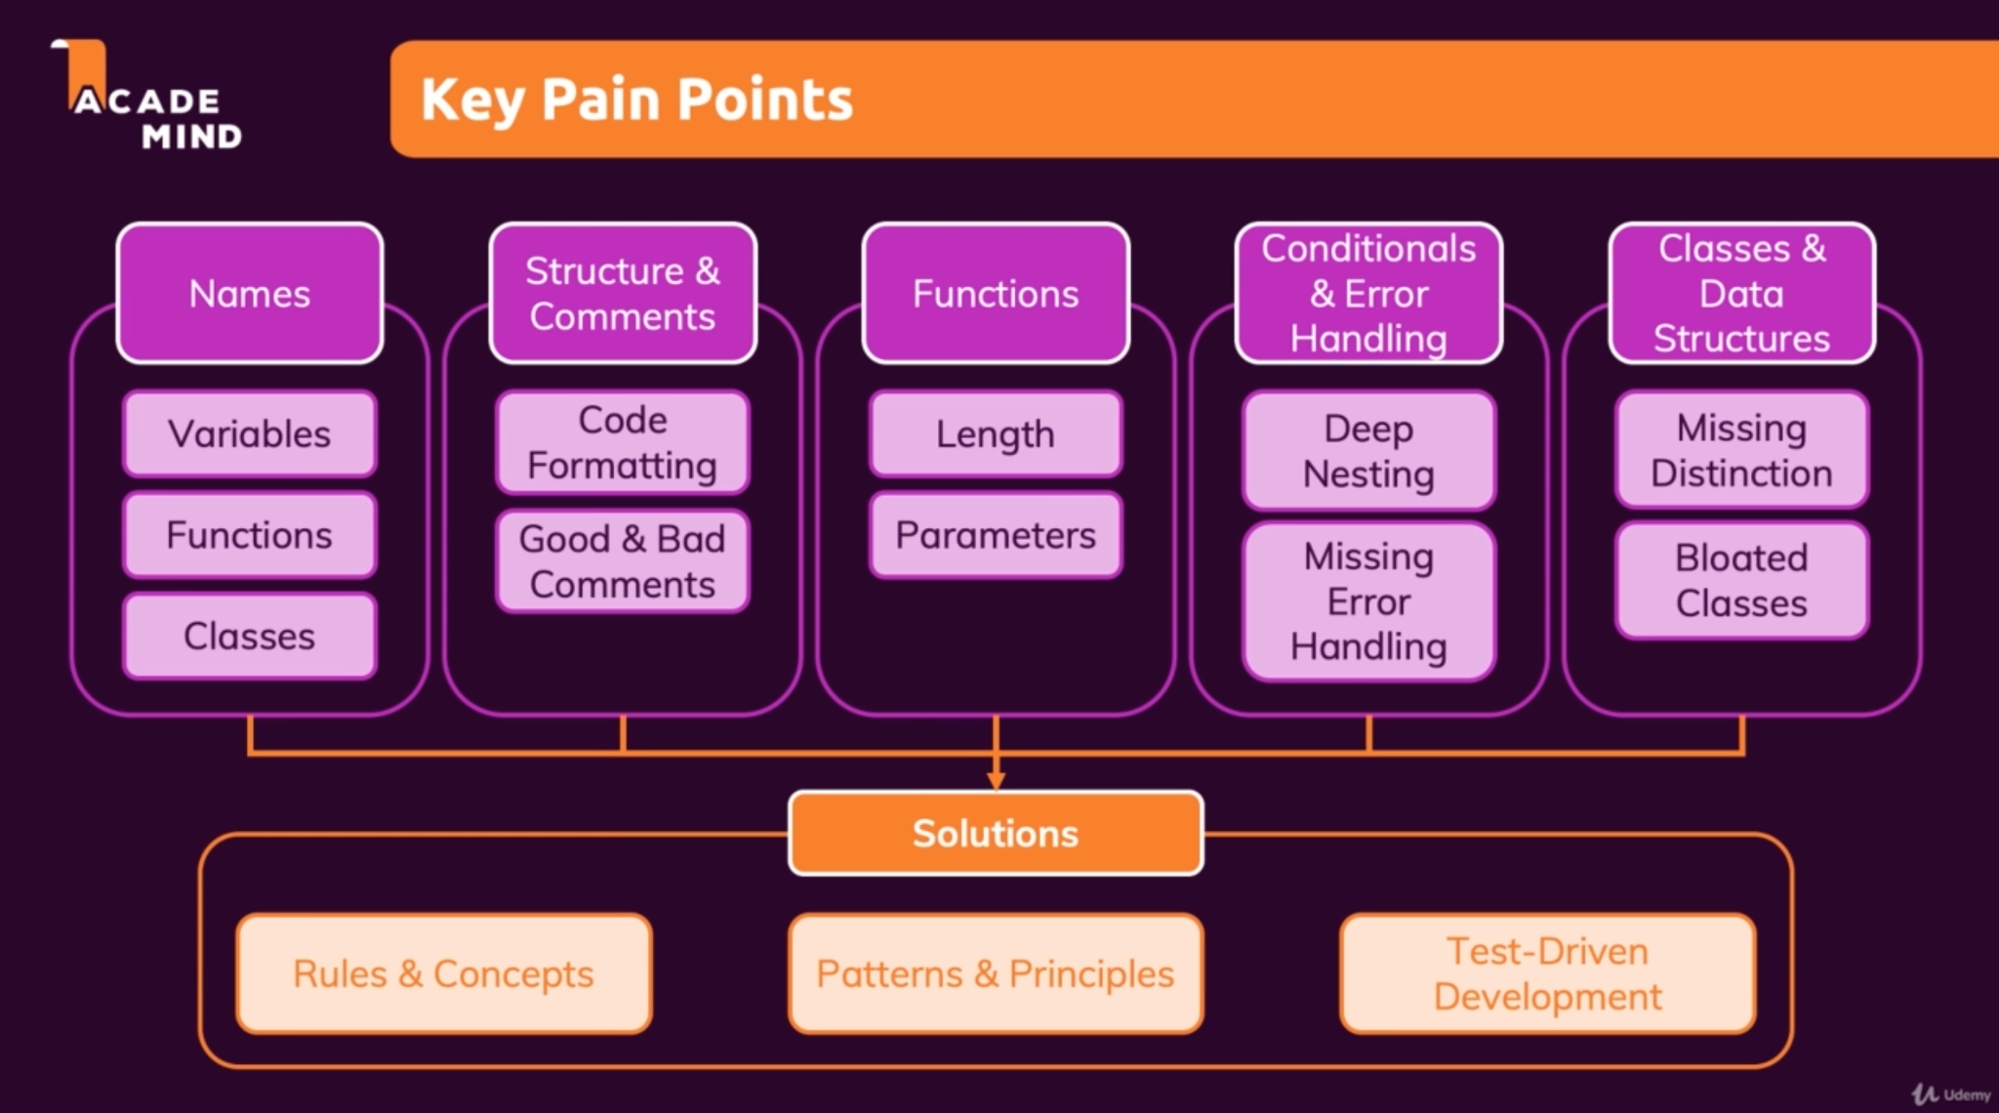
Clean Code Key Points

Slide 7
Naming Ex
Split into groups of 4-6

Slide 8
Names
Should be meaningful.
Should be clear but not redundant .
Stay consistent.

Slide 9
Variables Names (Nouns) - Each group should discuss
stores
Bad Name
Ok Name
Good Name
user object (email, name,age)
Array of orders
Input validation result
Us , u
Ords, list
V , val
userData
ordersList
correct ,valid
user
orders
isCorrect, isValid

Slide 10
Function Names (Commands) - Each group should discuss
does
Bad Name
Ok Name
Good Name
Save user in DB
Change order status
Validate input
process, handle
change
process
Save
updateTheStatus
Check
saveUser, user.save()
updateOrderStatus
isValid
Note: Validation variable or function named as questions

Slide 11
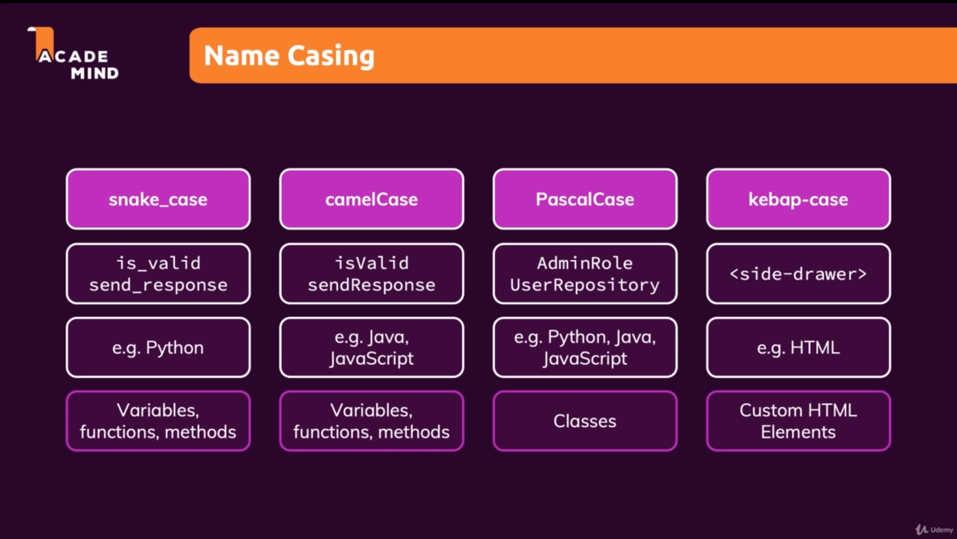

Slide 12
Comments Ex
Split into groups of 4-6

Slide 13
Comments
Avoid Comments!!
Mostly, If you need comments that means your code is not clean enough.

Slide 14
Bad Comments
Redundant information (consume time reading them)
Dividers Marks (make file unnecessary bigger)
Commented Code (use GitHub history)
Misleading Comments (Forget to update it)

Slide 15
Good Comments
Explain what can not be replaced by good naming
Warnings
Todo Notes
Legal Notes (copyrights)

Slide 16
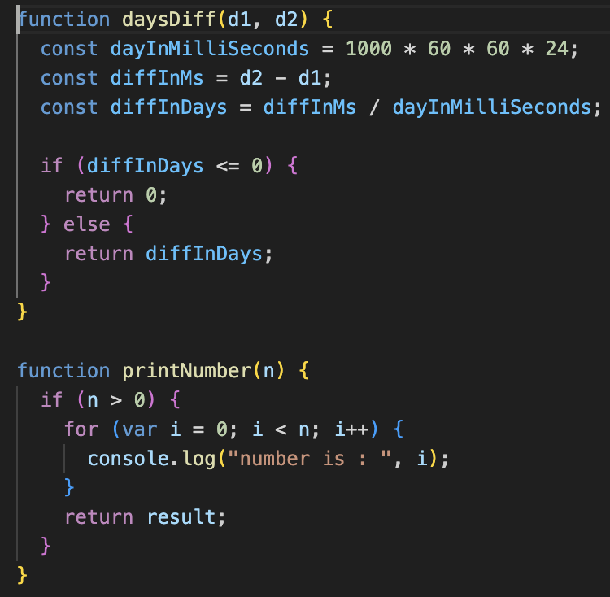
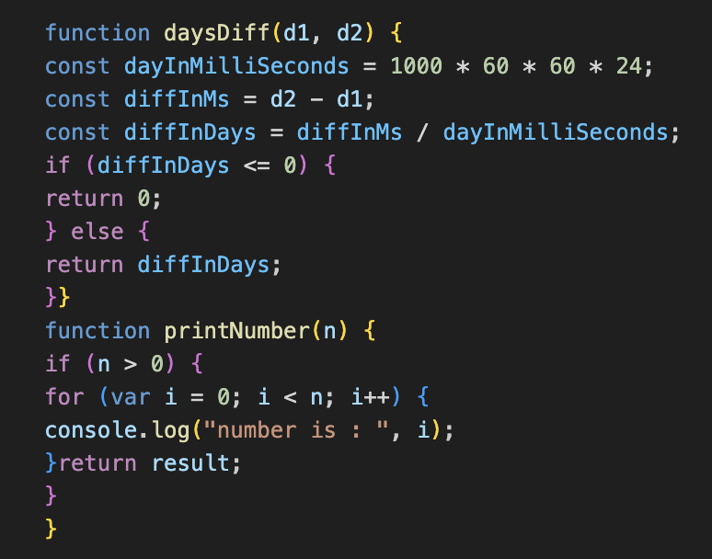
Formatting (spacing matters)
VS
Note: IDEs have helpful formatting tool, However make sure all your team members uses the same formatting tool

Slide 17
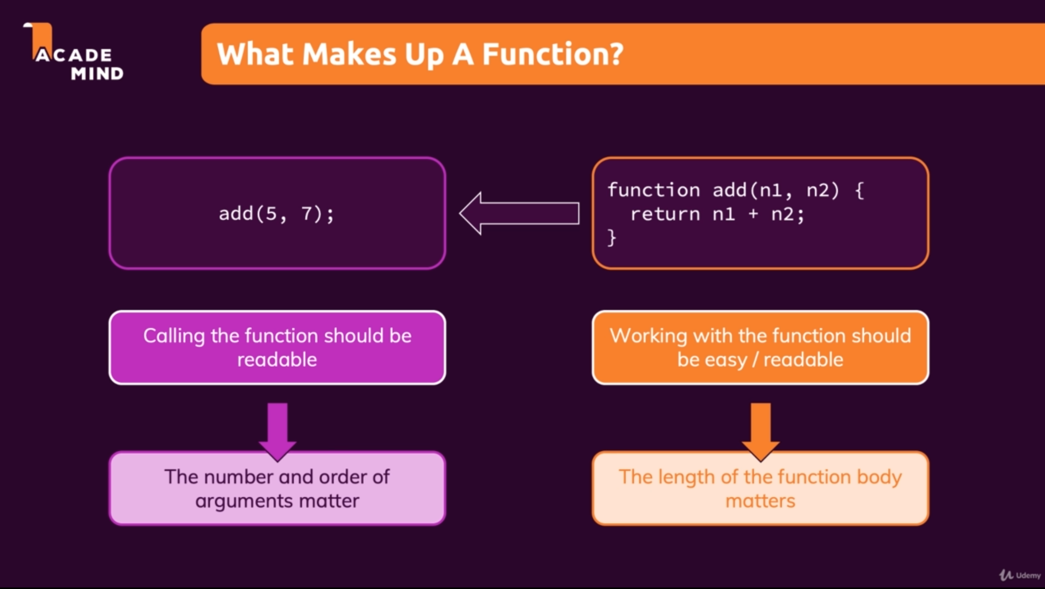
Functions

Slide 18
Functions Ex
Split into groups of 4-6

Slide 19
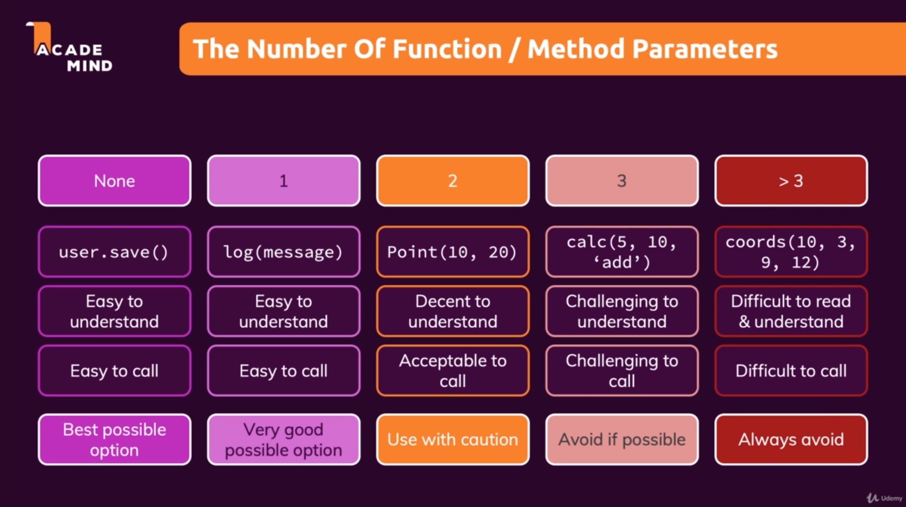
Functions Parameters

Slide 20
Functions Content
Does “One Thing”
Be as small as possible
DRY (Don’t Repeat Yourself)
Does not have mixed “Levels of Abstraction”

Slide 21
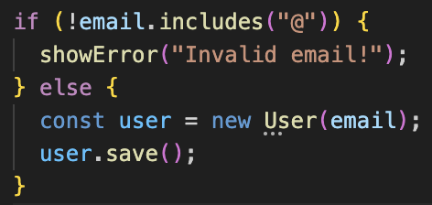
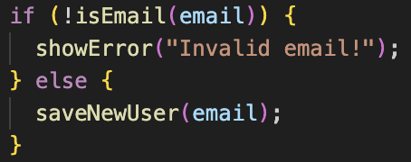
Levels of Abstraction
Low level
High level

Slide 22
General Rules
KISS (Keep It Simple Stupid)
  If you use your brian it is not KISS
DRY (Don’t Repeat Yourself)
  If you made the same change >1 it is not DRY
YANGI (You Aren’t Gonna Need It)
  If you don’t need now remove it now
  If you need it then use github history
Use common sense when applying clean code rules
  Rules are not a checklist must be done they are only here to make you question your code

